Slide 1

Hough Transform
Alon Ziv & Ortal Azulay

Slide 2

Introduction
The Hough Line Transform is a transform used to detect straight lines.
The Hough transform was patented as U.S. Patent 3,069,654 in 1962 by Paul Hough and assigned to the U.S. Atomic Energy Commission with the name "Method and Means for Recognizing Complex Patterns". This patent uses a slope-intercept parametrization for straight lines, which awkwardly leads to an unbounded transform space since the slope can go to infinity. Later the Hough transform has been extended to identifying positions of arbitrary shapes, most commonly circles or ellipses. The Hough transform as it is universally used today was invented by Richard Duda and Peter Hart in 1972, who called it a "generalized Hough transform"

Slide 3

Advantages & purposes of Hough Transform
Purpose
technique used in image analysis
computer vision
digital image processing
Advantage
The Hough Transform is tolerant of gaps in the edges
It is relatively unaffected by noise
It is also unaffected by occlusion in the image

Slide 4
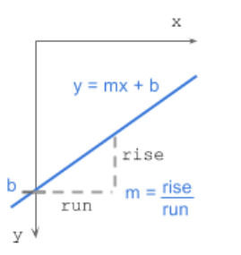
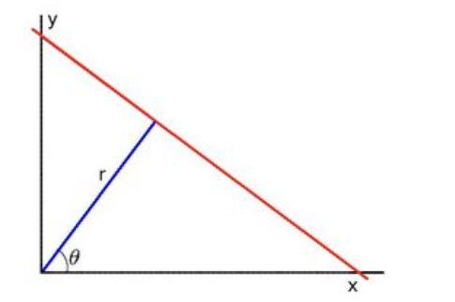
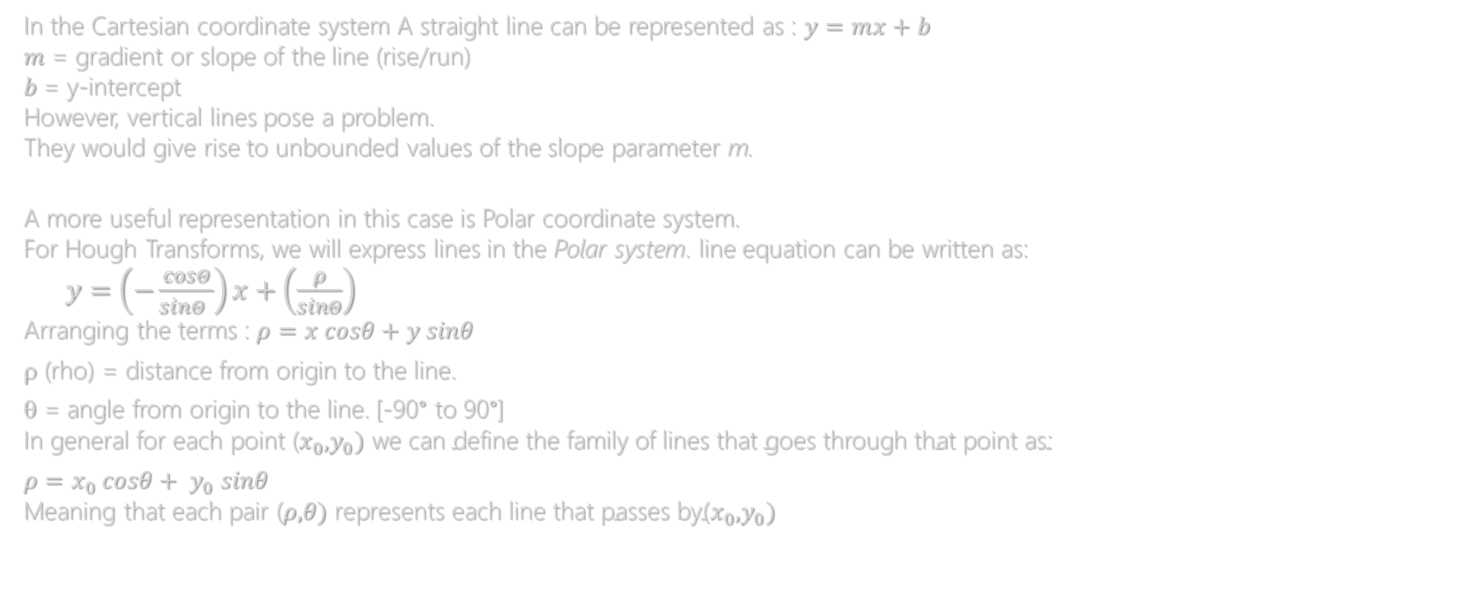
Hough Transform for Straight Line Detection
In the Cartesian coordinate system A straight line can be represented as : $y=mx+b$ $m$ = gradient or slope of the line (rise/run) $b$= y-intercept However, vertical lines pose a problem. They would give rise to unbounded values of the slope parameter m.
A more useful representation in this case is Polar coordinate system. For Hough Transforms, we will express lines in the Polar system. line equation can be written as: $y=\left(−\frac{cosΘ}{sinΘ }\right)x+\left(\frac{ρ}{sinΘ}\right)$ Arranging the terms : $ρ=x cosθ+y sinθ$
ρ (rho) = distance from origin to the line.
θ = angle from origin to the line. [-90° to 90°] In general for each point ($x_{0},y_{0}) \text{we} \text{can} \text{define} \text{the} \text{family} \text{of} \text{lines} \text{that} \text{goes} \text{through} \text{that} \text{point} \text{as}\text{:}$
$ρ=x_{0} cosθ+ y_{0} sinθ$ Meaning that each pair ($ρ,θ) \text{represents} \text{each} \text{line} \text{that} \text{passes} \text{by}\text{(}x_{0},y_{0})$

Slide 5
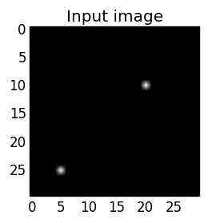
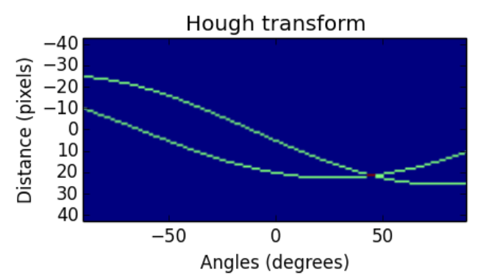
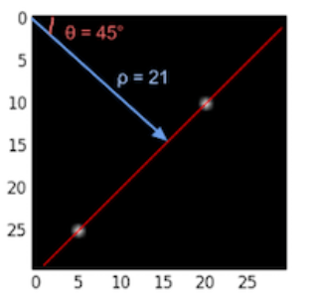
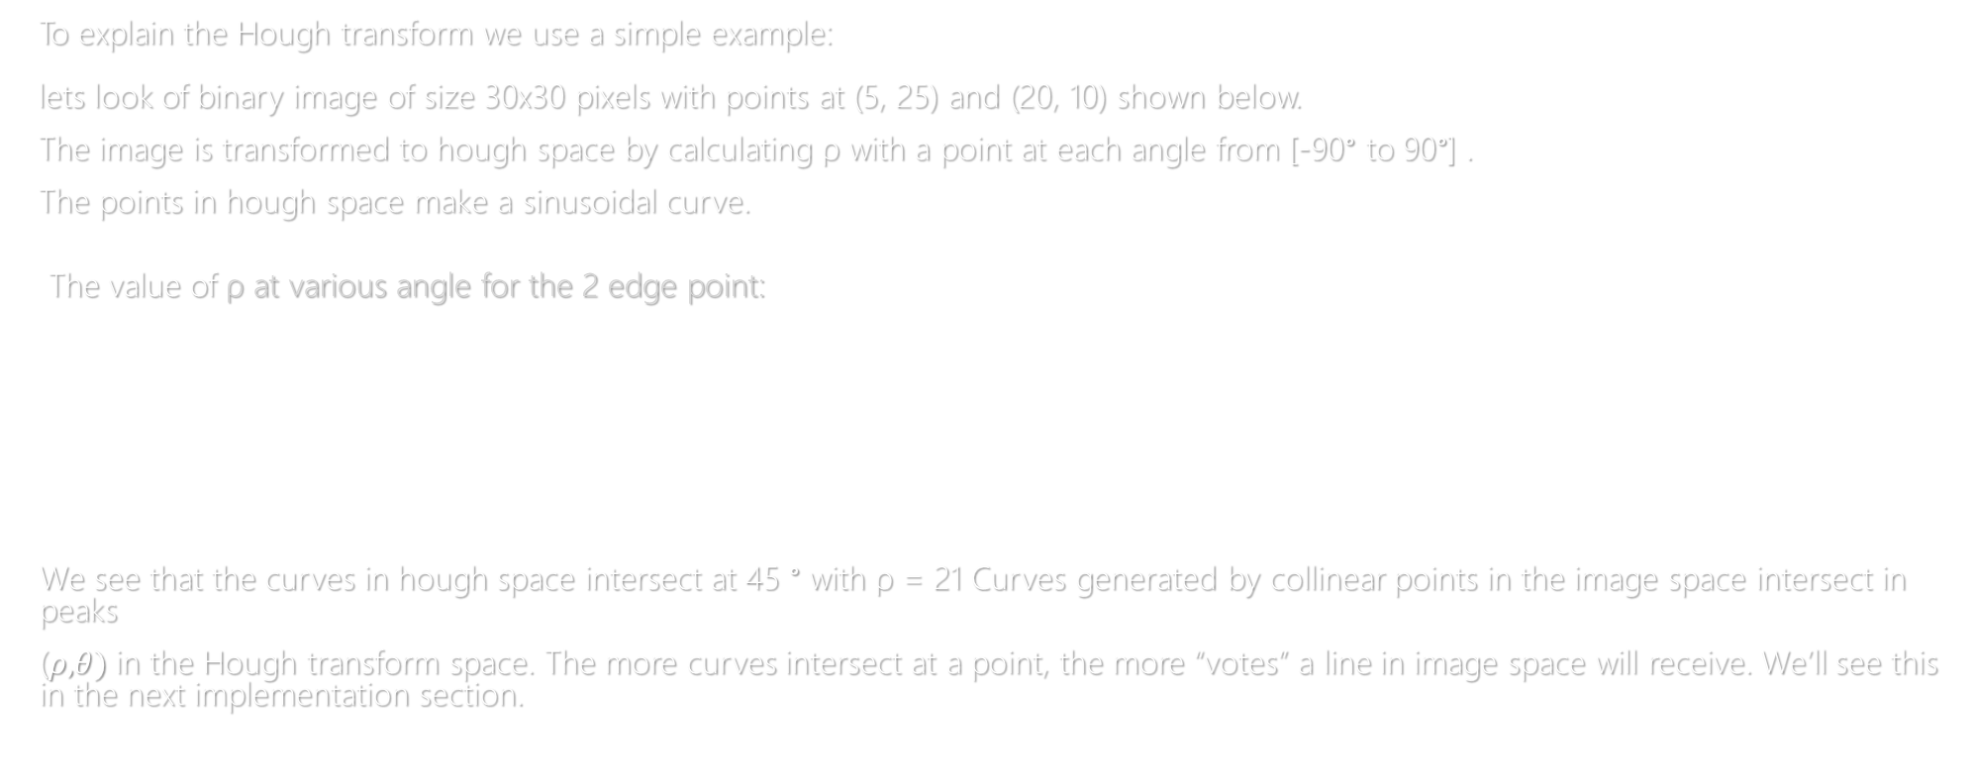
To explain the Hough transform we use a simple example: lets look of binary image of size 30x30 pixels with points at (5, 25) and (20, 10) shown below.
The image is transformed to hough space by calculating ρ with a point at each angle from [-90° to 90°] .
The points in hough space make a sinusoidal curve.
The value of ρ at various angle for the 2 edge point:
We see that the curves in hough space intersect at 45 ° with ρ = 21 Curves generated by collinear points in the image space intersect in peaks
($ρ,θ)$ in the Hough transform space. The more curves intersect at a point, the more “votes” a line in image space will receive. We’ll see this in the next implementation section.
point | -90° | -45° | 0° | 45° | 90°
(5,25) | -25 | -14 | 5 | 21 | 25
(10,20) | -10 | 7 | 20 | 21 | 10

Slide 6

Algorithm steps
Corner or edge detection. (using canny, sobel, adaptive thresholding). The resultant binary/grey image will have 0s indicating non-edges and 1s or above indicating edges. This is our input image.
ρ range and θ range creation identify the maximum and minimum values of ρ and θ .
Hough accumulator of ρ and θ ( using any struct is matched to the definition of the accumulator : 2d array, dictionary ,list)
Voting in the accumulator. For each edge point and for each θ value, find the nearest ρ value and increment that index in the accumulator. Each element tells how many points / pixels contributed “votes” for potential line candidates with parameters (ρ, θ ).
Peak finding. Local maxima in the accumulator indicates the parameters of the most prominent lines in the input image. Peaks can be found most easily by applying a threshold or a relative threshold.

Slide 7
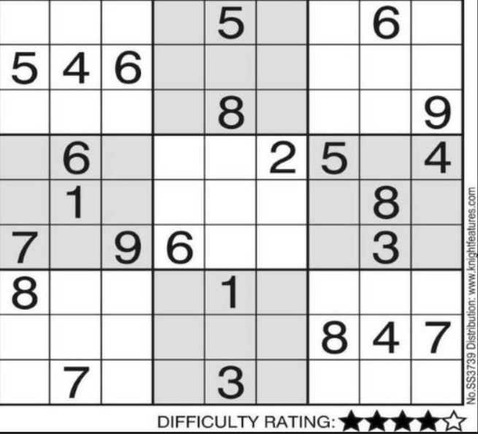
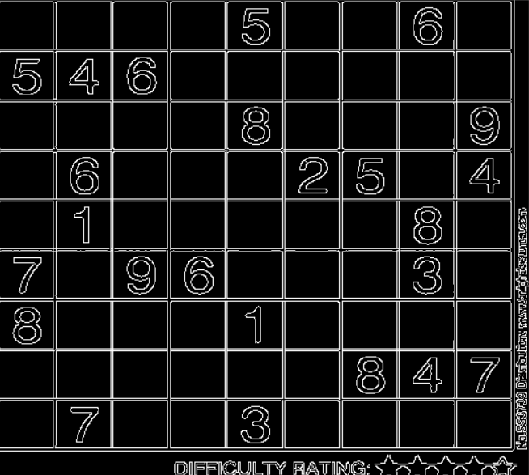
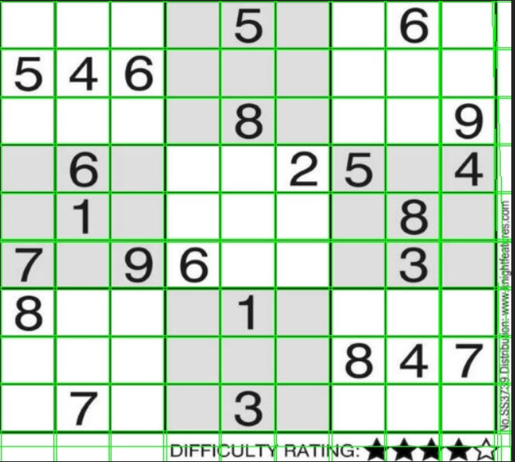
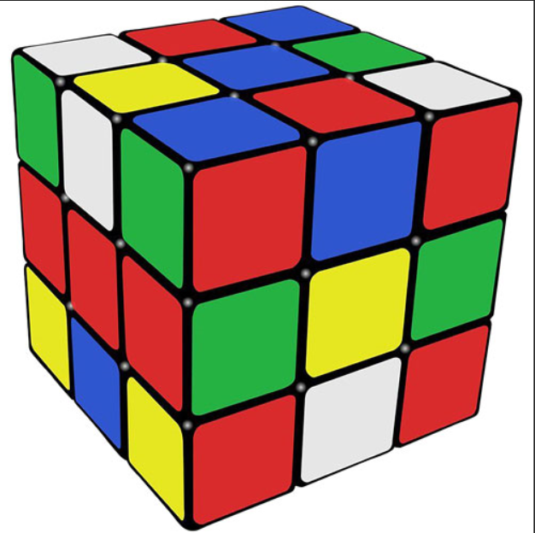
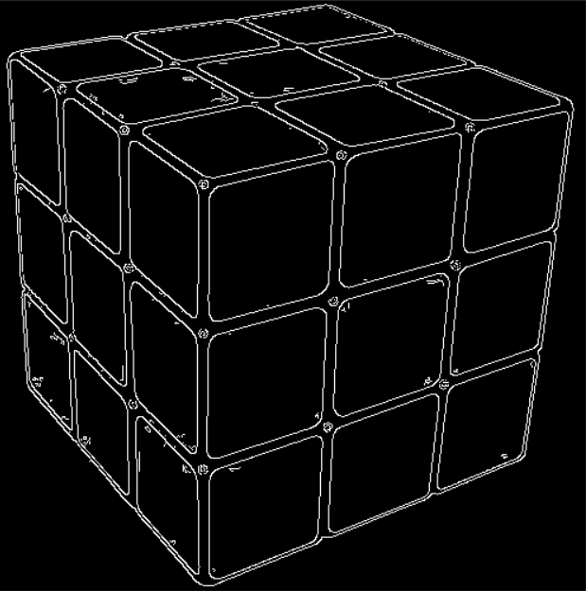
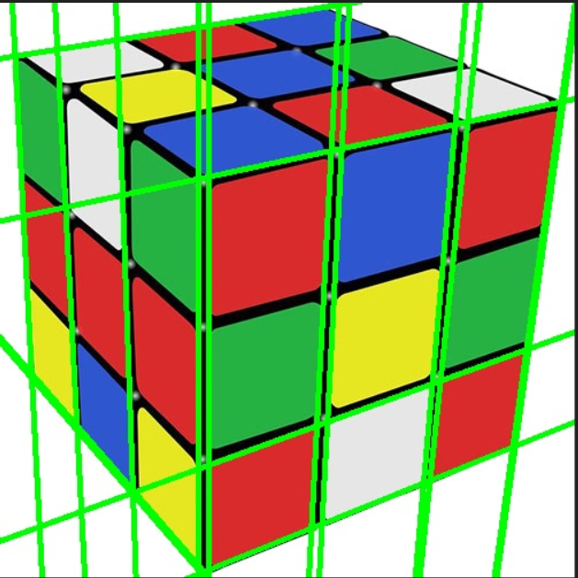
Input image
Canny
output image

Slide 8


Difficulties & Ways of coping
One of the most difficult is to build the accumulator .
In the procedure of “vote” how to vote for any point in the accumulator .
How to optimize the code and avoid unnecessary loops.
We build the accumulator with structure of Dictionary where the key was (ρ,θ) and the value is the “vote” after we convert to array to drew the line .
Because we choose to build the accumulator as a dictionary we use of build function to “vote” and choice what the local maximum (threshold)
To optimize the code we check if we can write different and we check the time lapse for the code . We try to avoid from loop if we can and calculate not in python .

